Slide 1
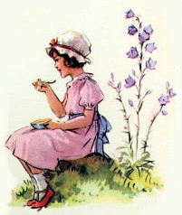
Little Miss Muffet
illustrations by
Margaret Tarrant
<number>
Notes:
1st time through, comment on the art and the story elements.
Reading 2 is the performance of the rhyme.
1: tuffet, definition

Slide 2
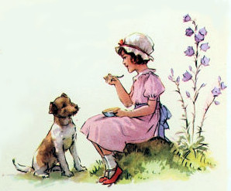
Little Miss Muffet
Sat on a tuffet
eating her
curds &
whey
<number>
Notes:
1: What is she eating? Cottage cheese~curds and whey (凝乳 【ぎょうにゅう】gyounu~curdled milk; 乳清 【にゅうせい】nyuusei~whey )
The dog is added in for the artwork, by Margaret Tarrant, and is not part of the background story
2 Little Miss Muffet
Sat on a tuffet
Eating her curds and whey

Slide 3
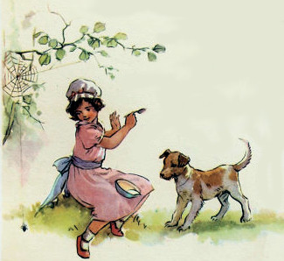
Along came a spider
who sat down
beside
her
<number>
Notes:
1 In the story, the spider “came along”, which means it was walking and found Little Miss Muffet and walked up close to her.
2 Along came a spider
Who sat down beside her

Slide 4
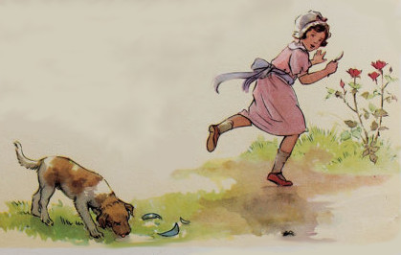
And frightened
Miss Muffet
away.
<number>
Notes:
1 Frightened her away
Scared her off
2 And frightened Miss Muffet away.

Slide 5
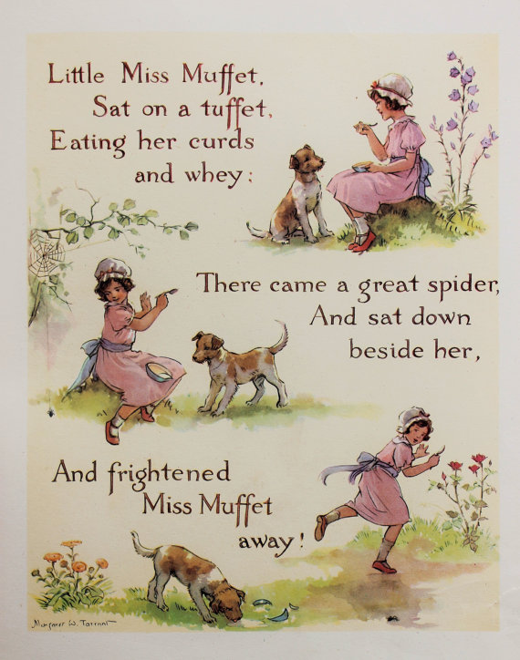
<number>
Notes:
Original artwork by Margaret Tarrant

